Slide 1

Artificial intelligence
Trabelsi Oussema | Rabonarijaona Solofo

Slide 2


SOMMAIRE:
Introduction
History
The Principle of Ai
Goals
Application
Conclusion and Future of Ai

Slide 3


Intelligence ?
What is Artificial Intelligence ??

Slide 4
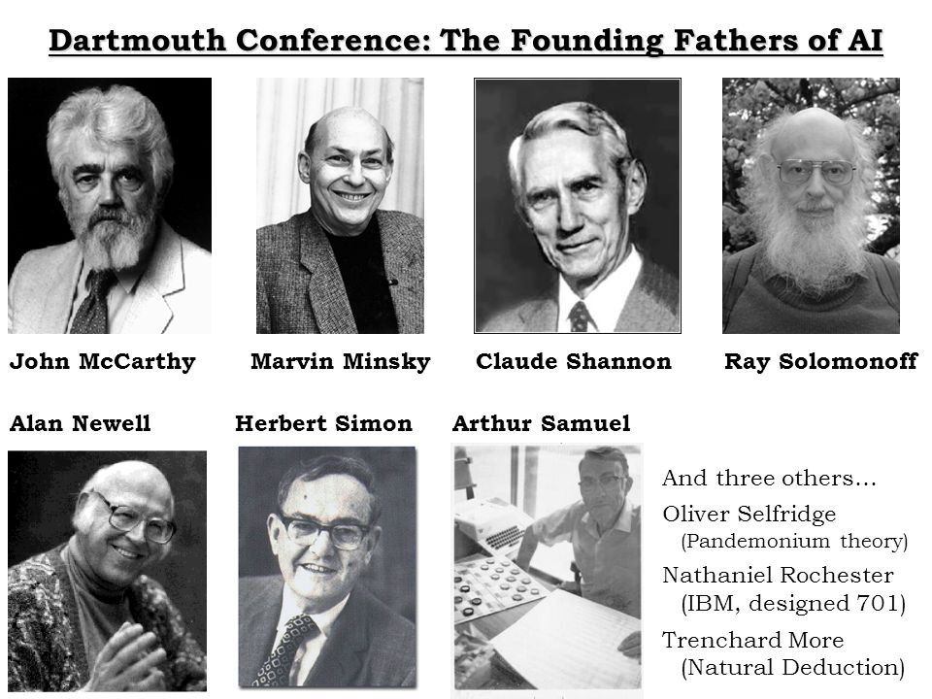
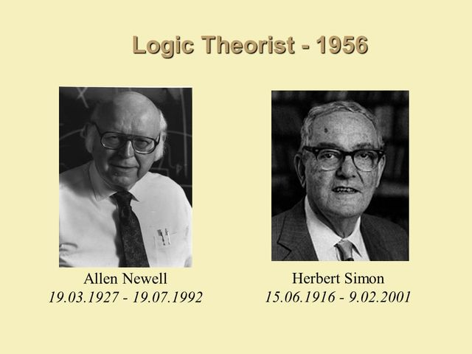
HISTORY:
1956
Dartmouth Conference

Slide 5
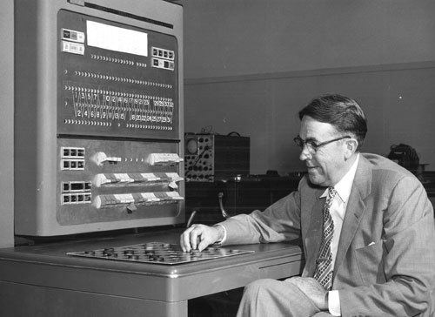
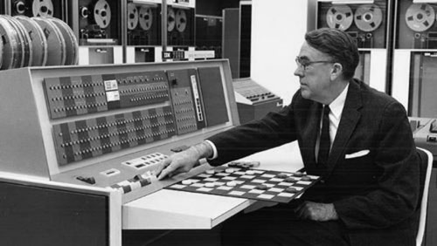
HISTORY:
1956
1952-62
First game-playing program:

Slide 6
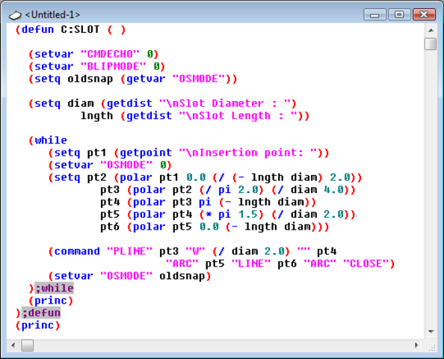

HISTORY:
1956
1952-62
1958
Lisp language:

Slide 7

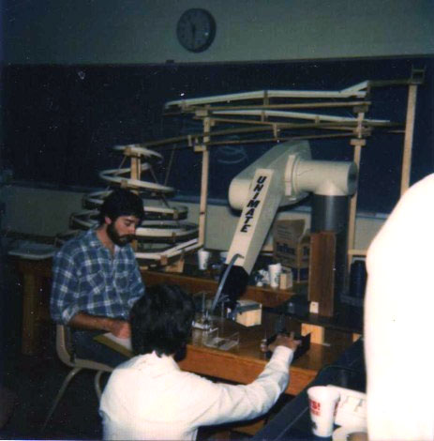
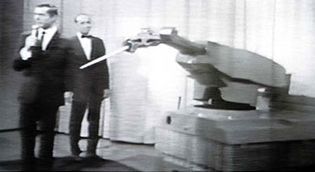
HISTORY:
1956
1952-62
1958
1962
Unimation Founded:

Slide 8


HISTORY:
1956
1952-62
1958
1962
1963
DARPA Advanced Research Projects:
Defense Advanced
Research Projects Agency

Slide 9
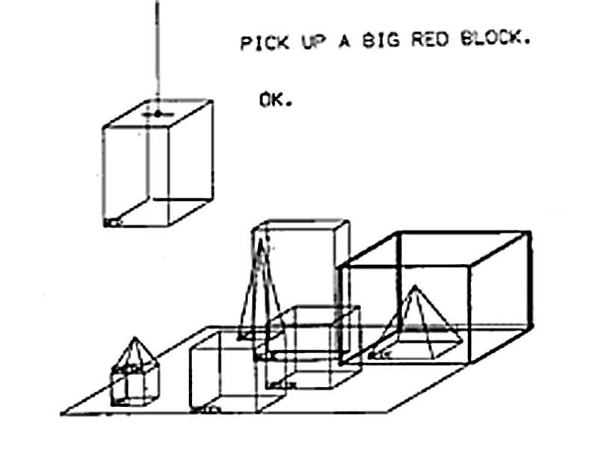
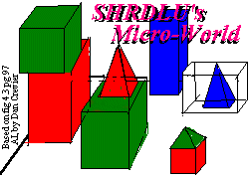
HISTORY:
1956
1952-62
1958
1962
1963
1968
Microworld Program, SHRDLU Created :

Slide 10
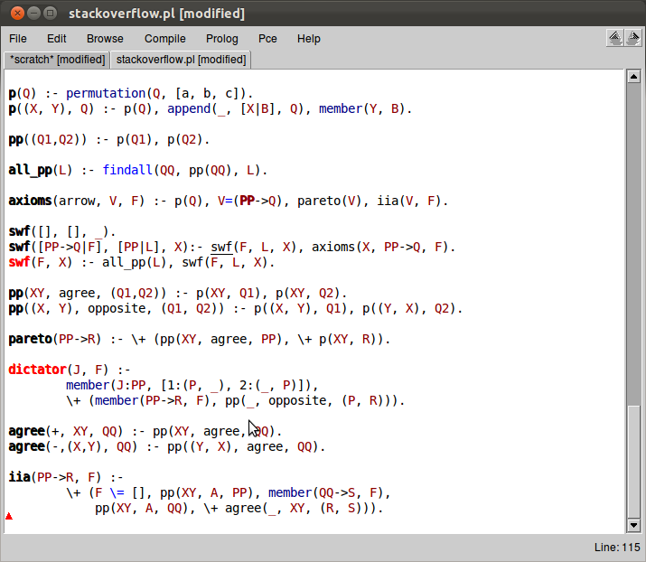


HISTORY:
1956
1952-62
1958
1962
1963
1968
1972
PROLOG Language Revealed :

Slide 11
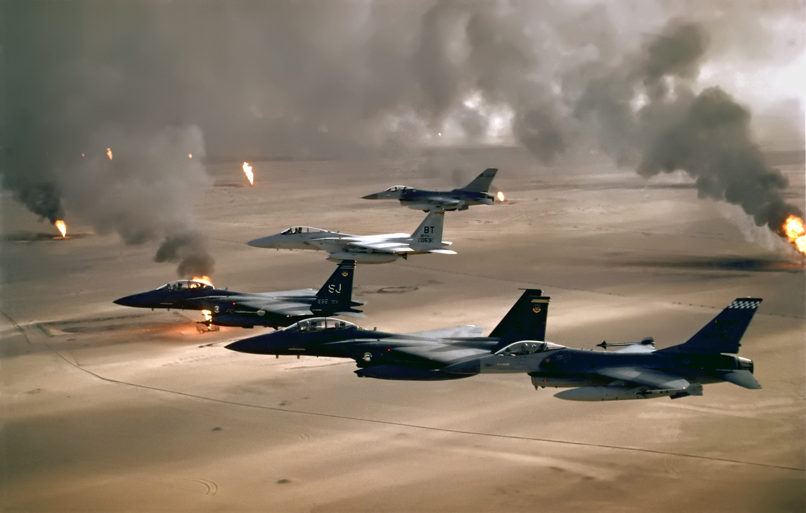
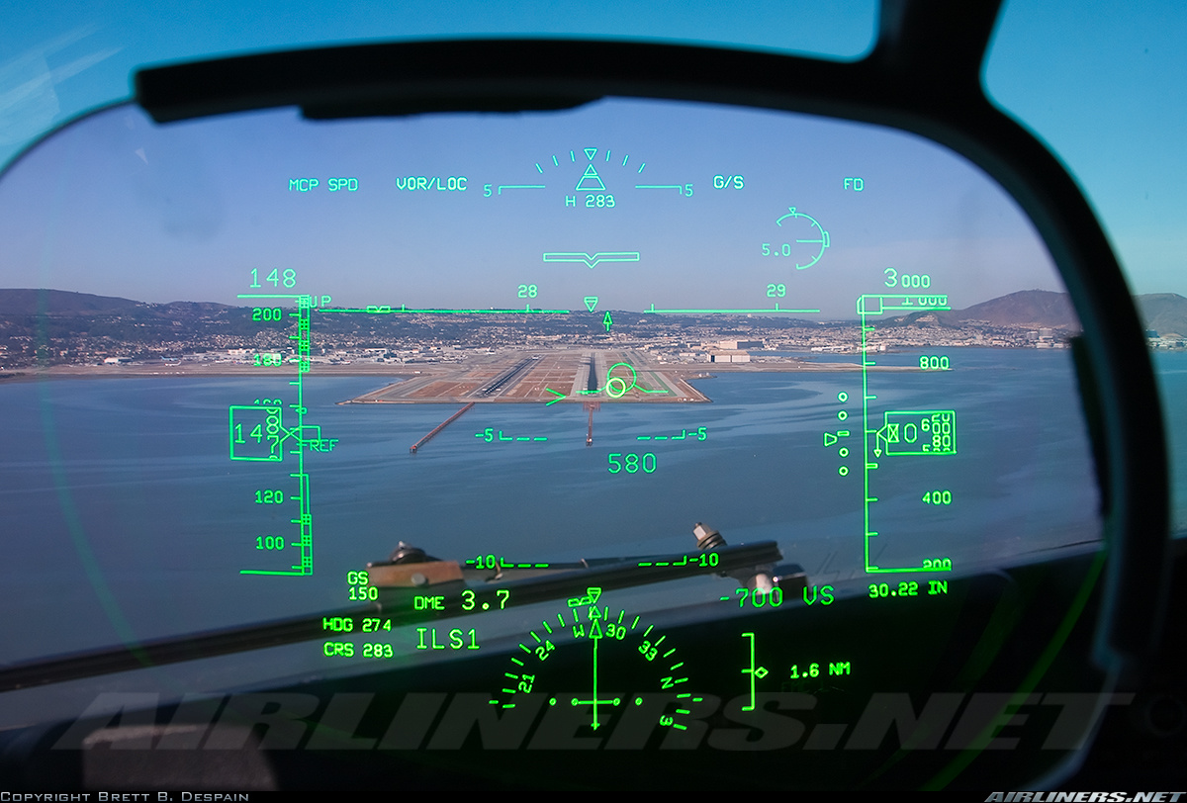
HISTORY:
1956
1952-62
1958
1962
1963
1968
1972
1991
AI Military Systems used in Desert Storm:

Slide 12
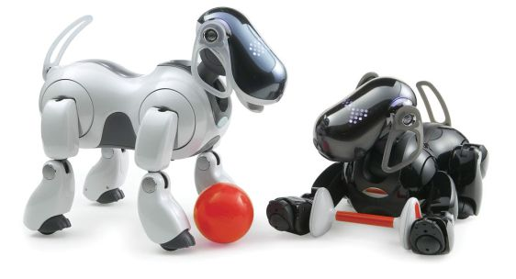

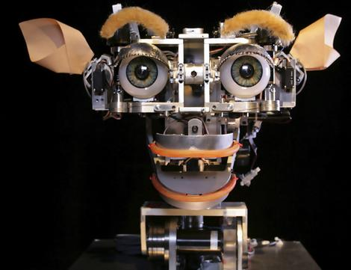
HISTORY:
1956
1952-62
1958
1962
1963
1968
1972
1991
2000’s
robot pets and KISMET robot:

Slide 13
The Principle of Ai
Intelligence (SIMULATION)
Machine learning

Slide 14
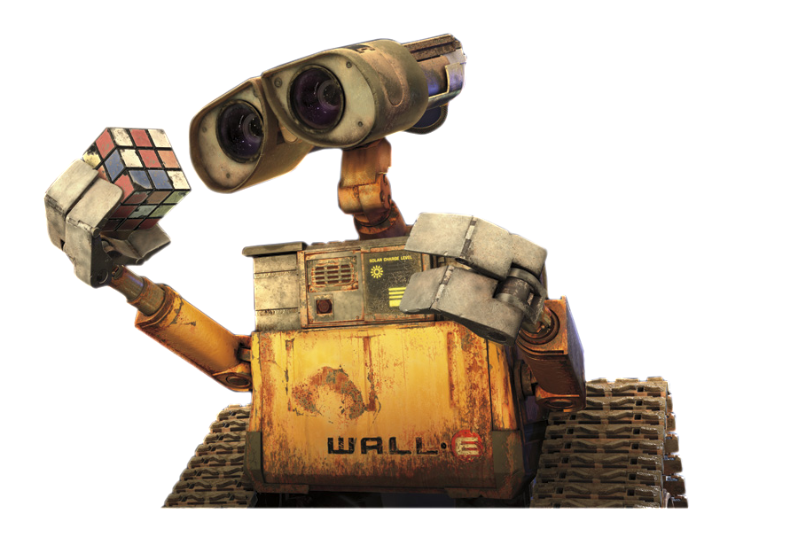
W.H.A.A.T N.E.E.X.T ?

Slide 15

I S.A.I.D !!
W.H.A.A.T N.E.X.T
??

Slide 16

SOLVE THE PROBLEM
SIMULATE INTELLIGENCE

Slide 17


INTELLIGENCE
LEARN
FROM
EXPERIENCE
EDUCATION

Slide 18
INFORMATION
OBSERVING
LEARN
FROM
LISTENING
EXPERIENCE
READING

Slide 19

MANIPULATING
INFORMATION
SOLVE PROBLEMS

Slide 20
INSTRUCTIONS
DATA
MANIPULATING
INFORMATION
SOLVE PROBLEMS
MACHINE LEARNING

Slide 21
THE ART BEHIND
MACHINE LEARNING

Slide 22
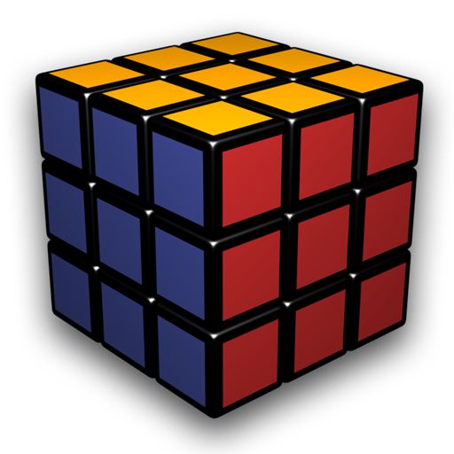

…… $

Slide 23


PRICE (M$)
150
135
100
50
SIZE (m²)

Slide 25
random
Sum errors
reduce errors

Slide 26
reduce errors
LINEAR REGRESSION
min

Slide 27

LINEAR REGRESSION
GRADIENT REGRESSION

Slide 28
POLYNOMIAL REGRESSION
DECISION TREE

Slide 29
LOGISTIC REGRESSION
NEURAL NETWORK

Slide 30
KERNEL TRICK
y = 1/x
K-MEANS CLUSTERING

Slide 31



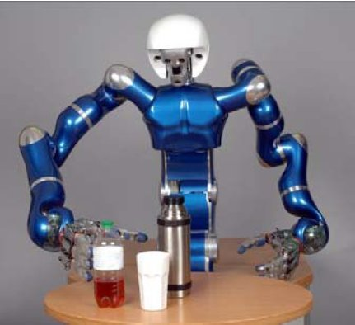
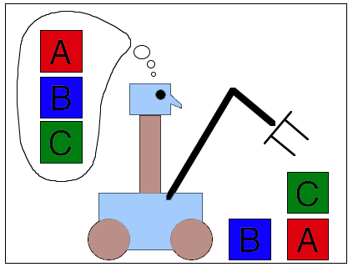

Goals:
Deduction , Reasoning ,problem sloving
Knowledge Representation
Planning
Natural language processing
Manipulation
Creativity

Slide 32





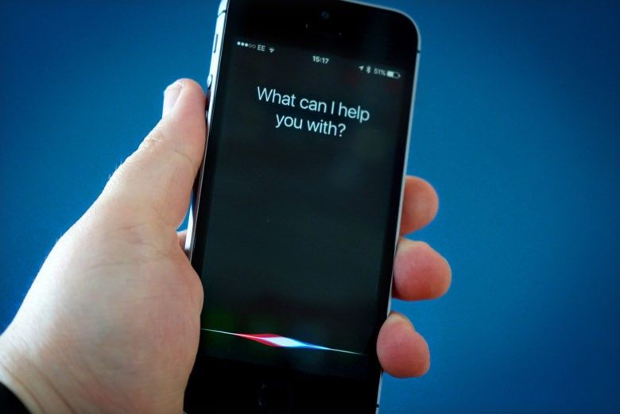
Application:
Music
Transportation
Hospitals
Medical Diagnosis
Toys and Games
Video Games
Expert systems
Question answering
Finance

Slide 33

CONCLUSION

Slide 34


